Slide 1
Switching Technologies
CSC 223

Slide 2
Switching techniques
The main objective of networking is to connect all the devices so that resources and information can be shared efficiently.
Whenever we have multiple devices, we have problem of connecting them to make one-to-one connection possible
A better solution is to uses switching

Slide 3
A switch network consists of a series of inter-linked nodes, called switches.
Switches are hardware and/or software capable of creating temporary connection between two or more devices linked to switch but not to each other.

Slide 4
Switching Techniques
In large networks there might be multiple paths linking sender and receiver. Information may be switched as it travels through various communication channels. There are three typical switching techniques available for digital traffic.
Circuit Switching
Message Switching
Packet Switching

Slide 5
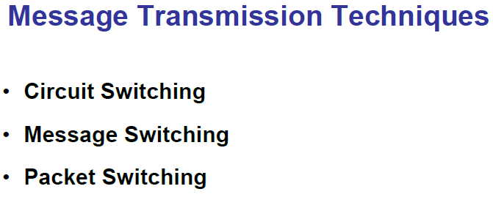

Slide 6
Circuit Switching
Circuit switching is a technique that directly connects the sender and the receiver in an unbroken path.
Telephone switching equipment, for example, establishes a path that connects the caller's telephone to the receiver's telephone by making a physical connection.
With this type of switching technique, once a connection is established, a dedicated path exists between both ends until the connection is terminated.
Routing decisions must be made when the circuit is first established, but there are no decisions made after that time.

Slide 7
Circuit Switching
Circuit switching in a network operates almost the same way as the telephone system works.
A complete end-to-end path must exist before communication can take place.
The computer initiating the data transfer must ask for a connection to the destination.
Once the connection has been initiated and completed to the destination device, the destination device must acknowledge that it is ready and willing to carry on a transfer.

Slide 8
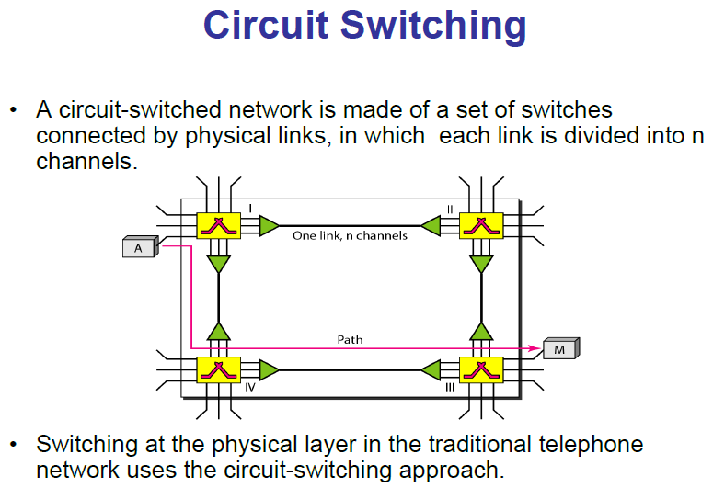

Slide 9
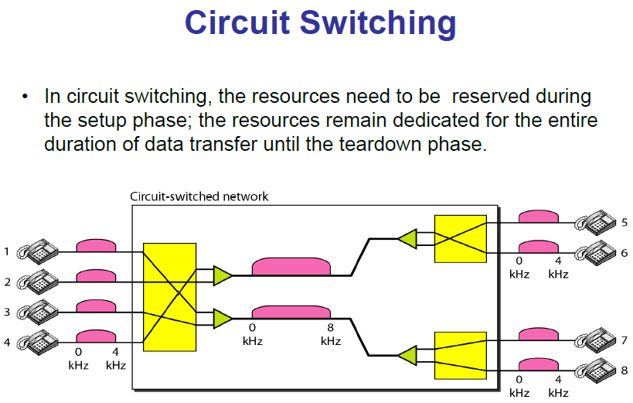

Slide 10
Circuit switching
Advantages:
The communication channel (once established) is dedicated.
Disadvantages:
Possible long wait to establish a connection, (10 seconds,
more on long- distance or international calls.) during which
no data can be transmitted.
More expensive than any other switching techniques,
because a dedicated path is required for each connection.
Inefficient use of the communication channel, because the
channel is not used when the connected systems are not
using it.

Slide 11
Message Switching
With message switching there is no need to establish a dedicated path between two stations.
When a station sends a message, the destination address is appended to the message.
The message is then transmitted through the network, in its entirety, from node to node.
Each node receives the entire message, stores it in its entirety on disk, and then transmits the message to the next node.
This type of network is called a store-and-forward network.

Slide 12
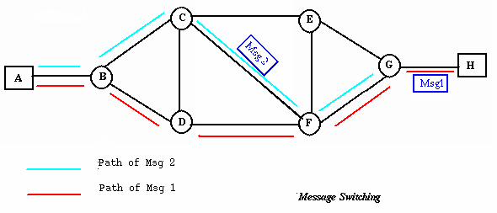
Message Switching
A message-switching node is typically a general-purpose computer. The device needs sufficient secondary-storage capacity to store the incoming messages, which could be long. A time delay is introduced using this type of scheme due to store- and-forward time, plus the time required to find the next node in the transmission path.

Slide 13
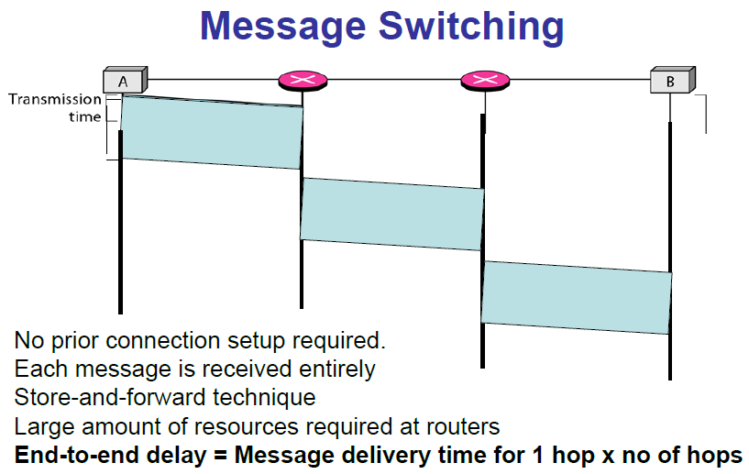

Slide 14
Message Switching
Advantages:
Channel efficiency can be greater compared to circuit- switched systems, because more devices are sharing the channel.
Traffic congestion can be reduced, because messages may be temporarily stored in route.
Message priorities can be established due to store-and-forward technique.
Message broadcasting can be achieved with the use of broadcast address appended in the message.

Slide 15
Message Switching
Disadvantages
Message switching is not compatible with interactive applications.
Store-and-forward devices are expensive, because they must have large disks to hold potentially long messages.

Slide 16
Packet Switching
In a packet switching data are transmitted in short packets. A typical packet length is 1000 byte. If a source has longer message to send, the message is broken up into a series of packets. Each packet contains a portion (or the entire short message) of the user‘s data plus some control information
These packets are routed to the destination via different available nodes.

Slide 17
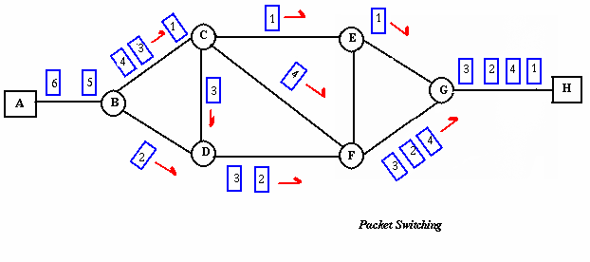
Packet Switching
Packet switching can be seen as a solution that tries to combine the advantages of message and circuit switching and to minimize the disadvantages of both.
There are two methods of packet switching: Datagram
and virtual circuit.

Slide 18
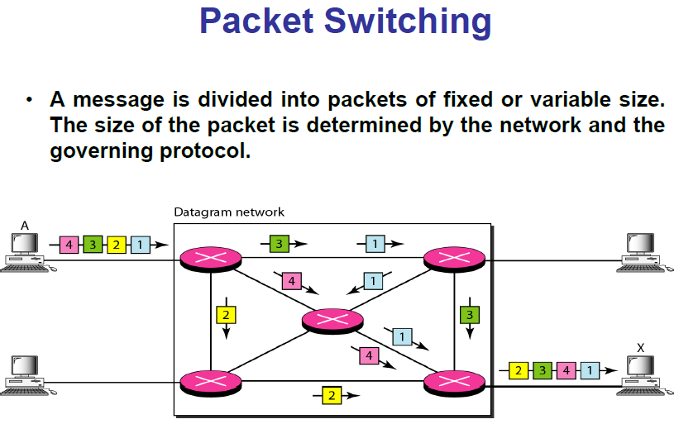

Slide 19
Packet Switching
In both packet switching methods, a message is broken into
small parts, called packets.
Each packet is tagged with appropriate source and destination
addresses.
Since packets have a strictly defined maximum length, they
can be stored in main memory instead of disk, therefore access delay and cost are minimized.
Also the transmission speeds, between nodes, are optimized.
With current technology, packets are generally accepted onto
the network on a first-come, first-served basis. If the network
becomes overloaded, packets are delayed or discarded
(``dropped'').

Slide 20
Packet switching
In packet switching, the analog signal from a phone is converted into a digital data stream. That series of digital bits is then divided into relatively tiny clusters of bits, called packets.
Each packet has at its beginning the digital address -- a long number -- to which it is being sent. The system blasts out all those tiny packets, as fast as it can, and they travel across digital backbone systems to their destination: the telephone, or rather the telephone system, of the person you're calling.

Slide 21
They do not necessarily travel together; they do not travel sequentially. They don't even all travel via the same route. But eventually they arrive at the right point -- that digital address added to the front of each string of digital data -- and at their destination are reassembled into the correct order, then converted to analog form, so the recipient can understand what the sender is saying.

Slide 22
Packet Switching: Datagram
Datagram packet switching is similar to message switching in
that each packet is a self-contained unit with complete
addressing information attached.
This fact allows packets to take a variety of possible paths
through the network.
So the packets, each with the same destination address, do not
follow the same route, and they may arrive out of sequence at
the exit point node (or the destination).
Reordering is done at the destination point based on the
sequence number of the packets.
It is possible for a packet to be destroyed if one of the nodes on
its way is crashed momentarily. Thus all its queued packets may
be lost.

Slide 23
Packet Switching:Virtual Circuit
In the virtual circuit approach, a preplanned route is established
before any data packets are sent.
A logical connection is established when
A sender sends a "call request packet" to the receiver and
the receiver send back an acknowledge packet "call accepted
packet" to the sender if the receiver agrees on conversational
parameters.
The conversational parameters can be maximum packet sizes,
path to be taken, and other variables necessary to establish and
maintain the conversation.
Virtual circuits imply acknowledgements, flow control, and error
control, so virtual circuits are reliable.
That is, they have the capability to inform upper-protocol layers
if a transmission problem occurs.

Slide 24
Packet Switching:Virtual Circuit
In virtual circuit, the route between stations does not mean that this is a dedicated path, as in circuit switching.
A packet is still buffered at each node and queued for output over a line.
The difference between virtual circuit and datagram approaches:
With virtual circuit, the node does not need to make a routing decision for each packet.
It is made only once for all packets using that virtual circuit.

Slide 25
Packet Switching: Virtual Circuit
VC's offer guarantees that the packets sent:
Arrive in the order sent
With no duplicates or omissions
With no errors regardless of how they are implemented internally.

Slide 26
Advantages of packet switching
Advantages:
Packet switching is cost effective, because switching devices do not need massive amount of secondary storage.
Packet switching offers improved delay characteristics, because there are no long messages in the queue (maximum packet size is fixed).
Packet can be rerouted if there is any problem, such as, busy or disabled links.
Many network users can share the same channel at the same time. Packet switching can maximize link efficiency by making optimal use of link bandwidth.

Slide 27
Disadvantages of packet switching
Disadvantages:
Protocols for packet switching are typically more complex.
It can add some initial costs in implementation.
If packet is lost, sender needs to retransmit the data.
Packet-switched systems still can’t deliver the same quality as dedicated circuits in applications requiring very little delay - like voice conversations or moving images.

